Slide 1
Enterprise Information System Lab
'Set-Up and Showcase of E-Commerce System'
By: Naurin Jamil
Yarovoy Dmitri
Mentor : Dr Fabrizio Orlandi

Slide 2
Goals:
Intentioned :-
Outline the Architectural diagram for an E-Commerce system, say 'E-Markt'
Achieved :-
Created the Architectural diagram for the E-Commerce system using ARIS diagram editor

Slide 3
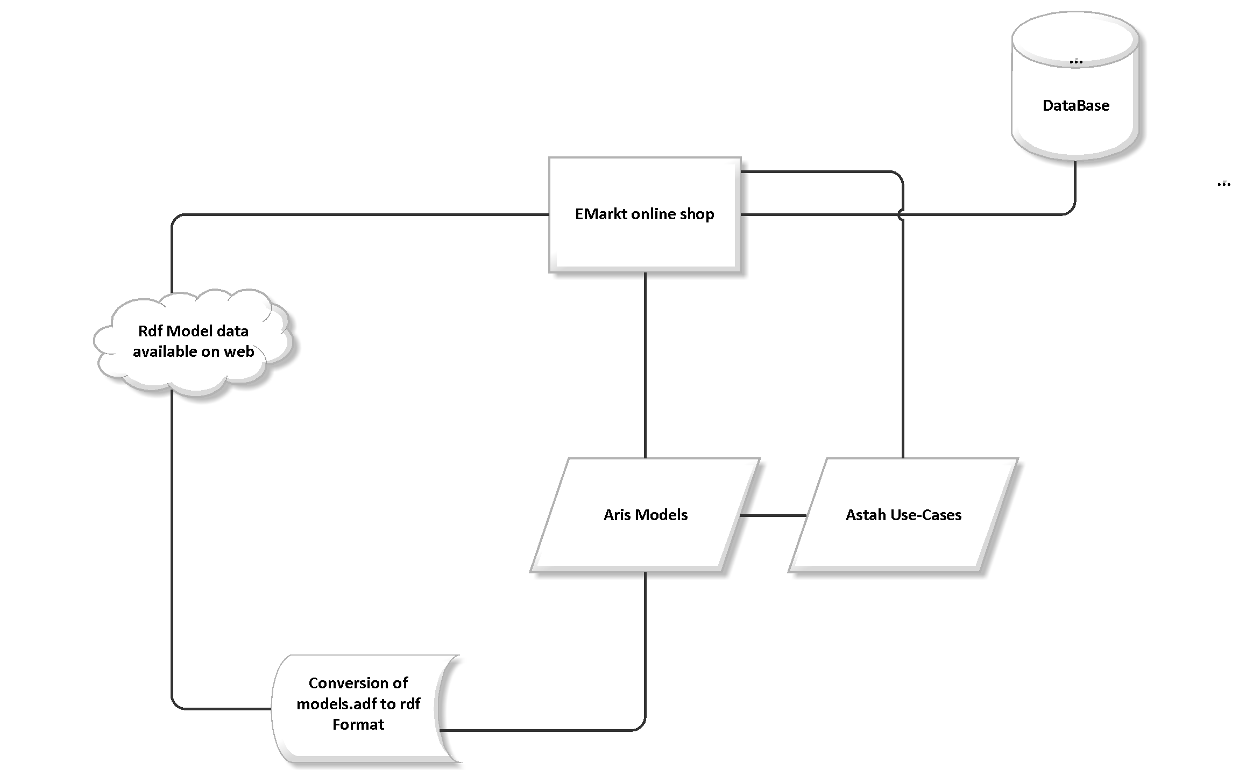
Architectural Diagram

Slide 4
Goals:
Intentioned :-
Specify the functional and non-functional requirements of 'E-Markt'
Achieved :-
Outlined the functional/non-functional requirements using standard requirement specification format

Slide 5
Goals:
Intentioned :-
Create use cases for covering all the requirements
Achieved :-
Designed Use cases for all the functional processes in the E-Markt system, using ASTAH UML designer

Slide 6
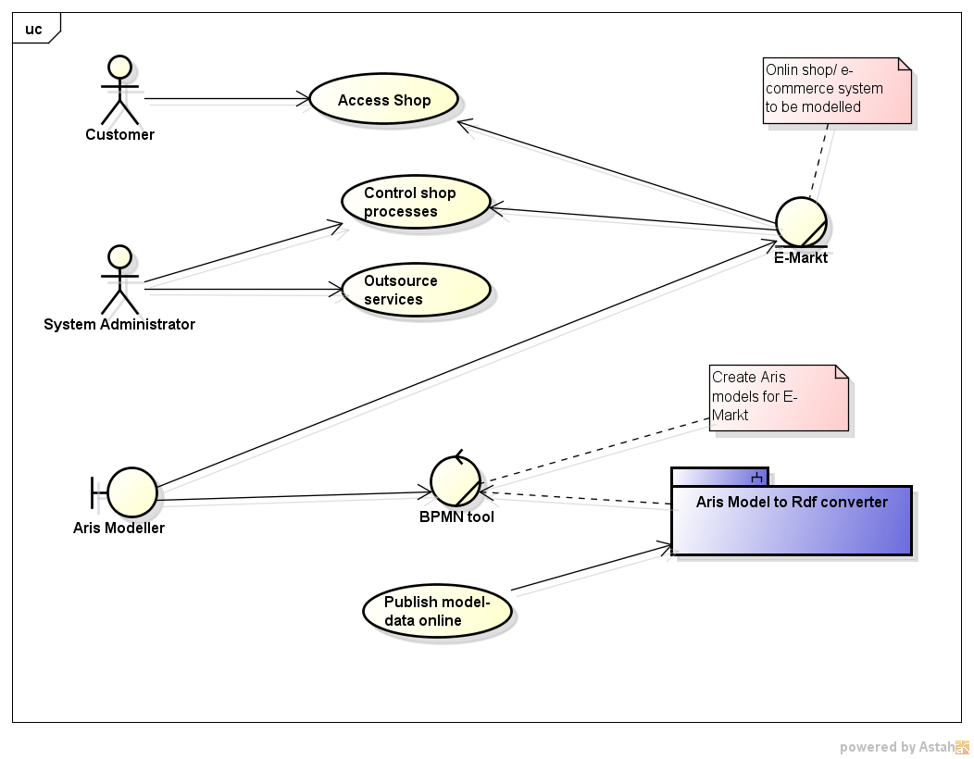
Use-Case (astah)

Slide 7
Goals:
Intentioned :-
Model Functional Process designs for all the use cases
Achieved :-
Designed Event Process Chain diagrams to cover all functional processes, using the modeling tool ARIS (version 9.6 and lower)

Slide 8
Event Process Chain diagram(ARIS)

Slide 9
Goals:
Intentioned :-
Cover other aspects of system design using modeling system
Achieved :-
Create other ARIS models for organizational structure, process landscape and Business Process models

Slide 10
Organigram (ARIS)

Slide 11
Goals:
Intentioned :-
Extract data from ARIS Models and convert to a generic format, like XML
Achieved :-
Execute a script written to extract ARIS model data to yield an XML report

Slide 12
Goals:
Intentioned :-
Convert the model data from XML to RDF
Achieved :-
The XML report generated is parsed and converted to RDF using popular existing Semantic Web ontologies. The output is a N3 rdf file

Slide 13
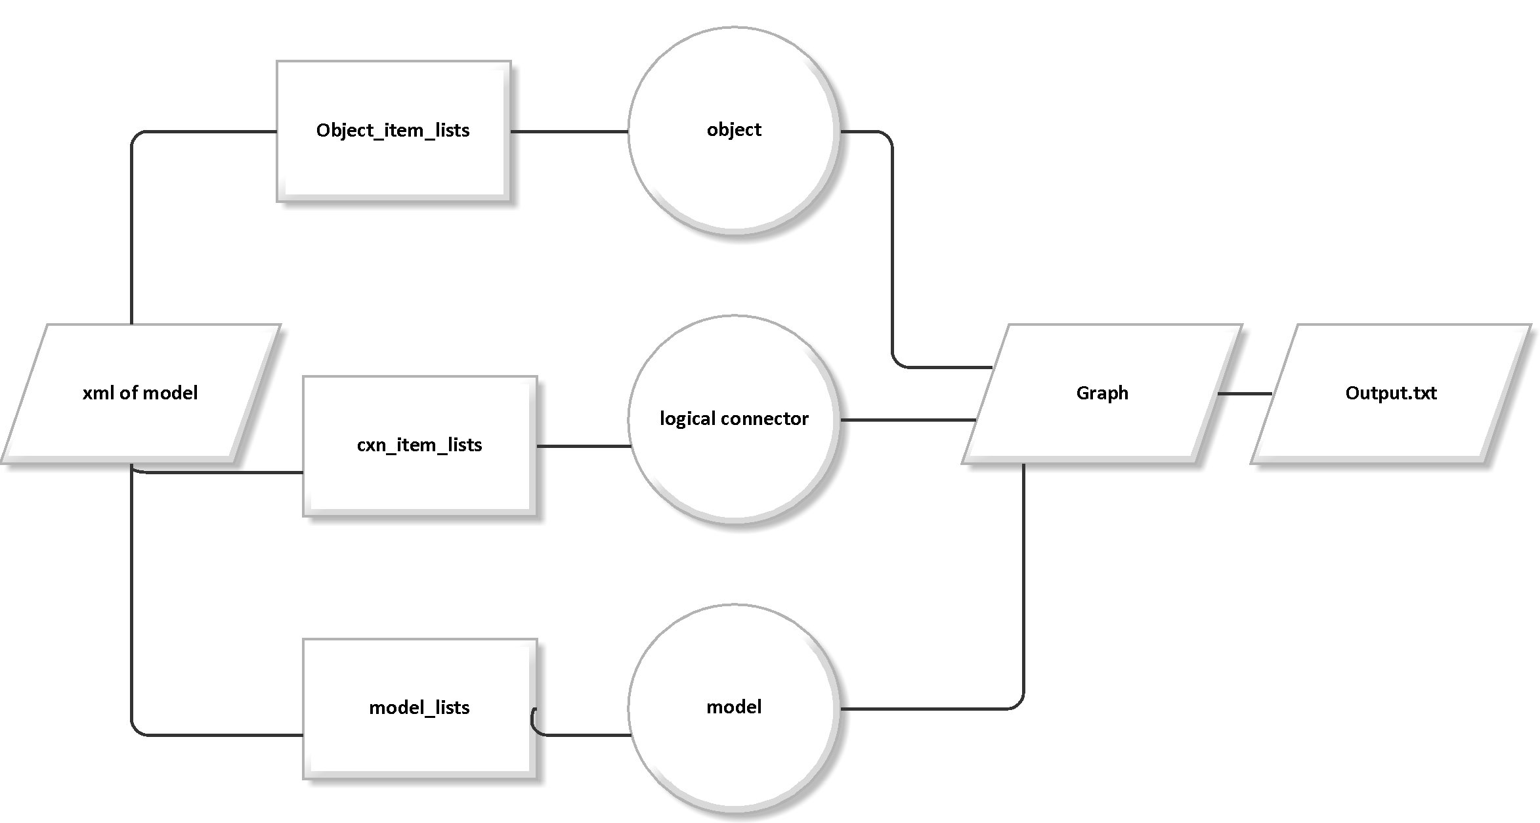
Implementation Diagram

Slide 14
Goals:
Intentioned :-
Outline all details regarding technical design, implementation and system description using 'Technical design document'
Achieved :-
Used standard Technical Design document format : http://wiz.cath.vt.edu/tw/TechnicalWriting/docdesign/index.htm

Slide 15
Goals:
Intentioned :-
Outline all details regarding using the system in the 'User Manual'
Achieved :-
Used standard user Manual Design document format : http://wiz.cath.vt.edu/tw/TechnicalWriting/docdesign/index.htm

Slide 16
Goals:
Intentioned :-
Test the code written for the export of data from XML to RDF format
Achieved :-
The python code is tested using simple unit test framework

Slide 17
Goals:
Intentioned :-
Verify the ARIS business process model designs
Achieved :-
The ARIS models are tested using the Semantic Check functionality built-in the ARIS 9.6 version, to generate test result.html

Slide 18
Strengths and Advantages
The utility of this project is to understand easily the functional processes involved in an E-Commerce system
The models are easy to understand, create, edit and incorporate
The conversion of models into the RDF format makes the model data easily shared and re-usable
Simplified tests to verify the models and their conversion

Slide 19
Project TimeLine
May
June
July-Aug
July-Aug
Sep
Use-Cases
Identify functional and non-functional requirements to design use-cases
ARIS Models
Design Aris models based upon the identified use-cases
Implementation
Code to convert models into XML then into RDF
Submission
Documentation, Testing , poster and presentation

Slide 20
References
http://ceur-ws.org/Vol-251/paper9.pdf - Semantic EPC: Enhancing Process Modeling
Using Ontology Languages
http://oro.open.ac.uk/20613/1/p7.pdf - The Business Process Modelling Ontology

Slide 21


